Slide 1



Internship (Software Engineering Intern)
Raj Kumar Maurya
CSJMA130010051

Slide 2
Internship site
Xerox Research Centre India (XRCI)
(Bangalore, India)
www.xrci.xerox.com/
Their main activities:
Research, Development and Implementation:
Automatic scaling algorithms for managing micro services based on load.
Education
Health Care
Crowd Sourcing
Notes:
Support System Development and Implementation:
Raising Capacities and Awareness
Registration of EHS Consultants
EHS Electronic Database
Conferences
International Cooperation
Incentives
<number>

Slide 3
Organization
Mission
Welcome to Xerox Research Centre India(XRCI), the youngest research centre at Xerox Corporation and the first of these famed research centres to be based in an emerging market. While Xerox is known for its pioneering work on photocopiers and printers, it is also today a premier services provider. Not only is Xerox the largest provider of managed print services, it is the leading provider of transportation services to governments across the world, a leader in providing business process services for healthcare to state governments and insurance companies and care management solutions to hospitals in the United States, and one of the largest worldwide providers of business process services for customer care.
Research Sectors:
Data Analytics
Algorithms and Optimization
Distributed and Mobile Computing
Software Lab

Slide 4
Where I was (Software Lab)
System & Policy
Design
Software Lab
Code Shipped to Production
Implementation
Communication & Awareness
Management (Code)

Slide 5
Tasks (My role: Software Engineering Intern)
Understanding the Software Structure
Collaborating Code on GitHub
Writing Efficient Cloud Code
Making API calls
Coding Server Side
Software Testing
Coding Client Side
Doing Research (UI / UX)
Software Debugging
Designing ( best practices for the user base)
Enhancing the Meta Data for the Product

Slide 6
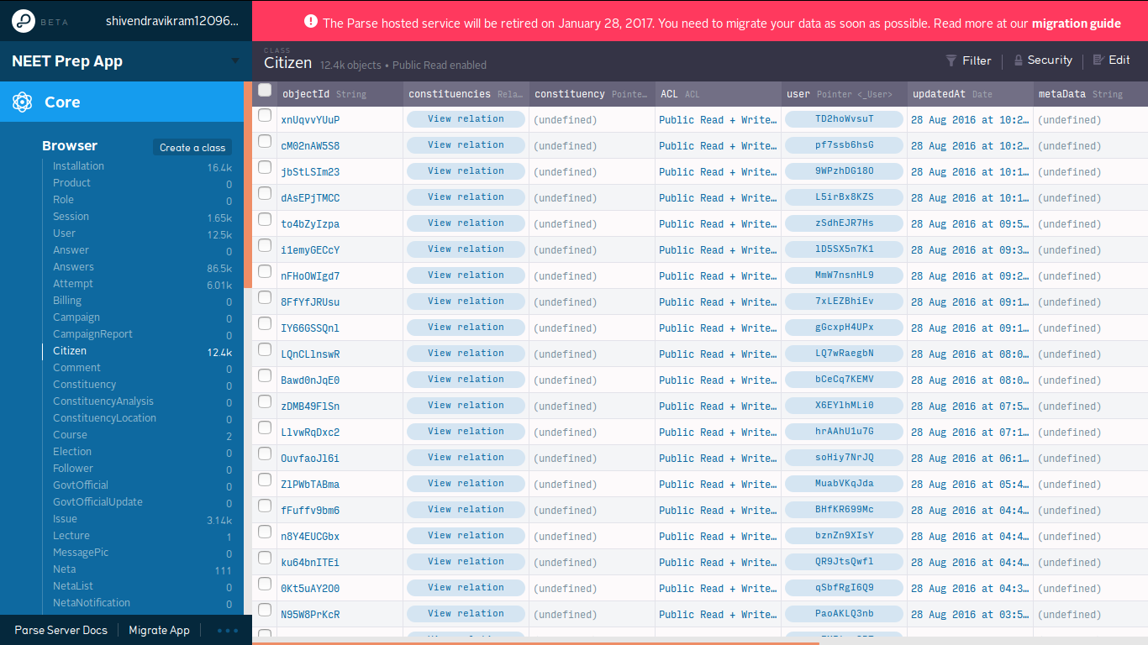
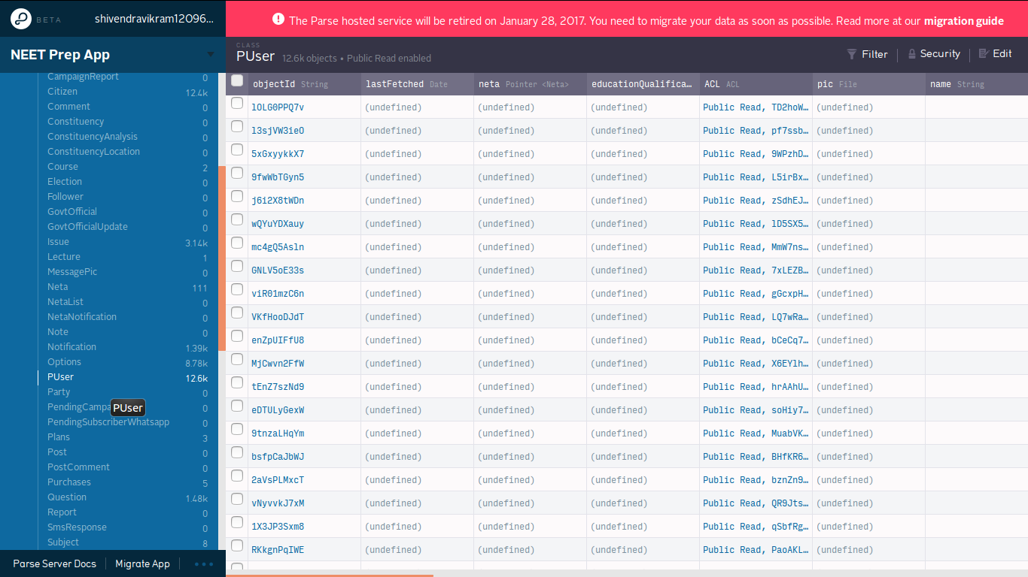
Database (Parse)

Slide 7
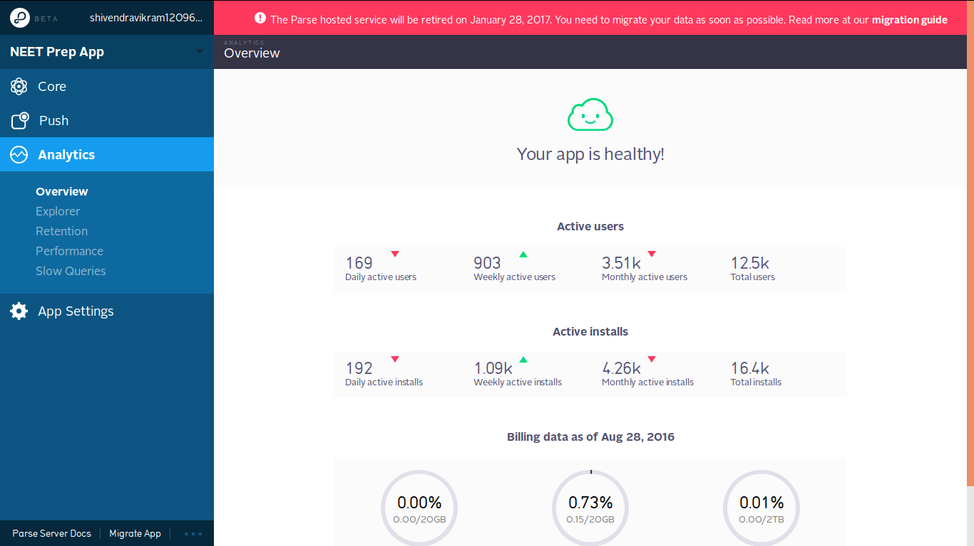
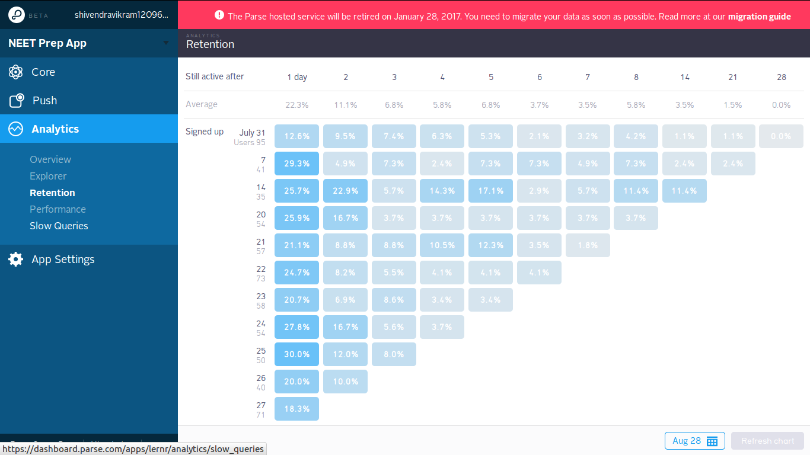
Database Analytics

Slide 8
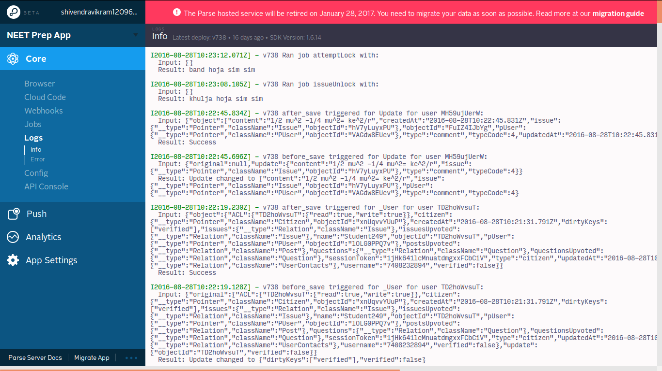
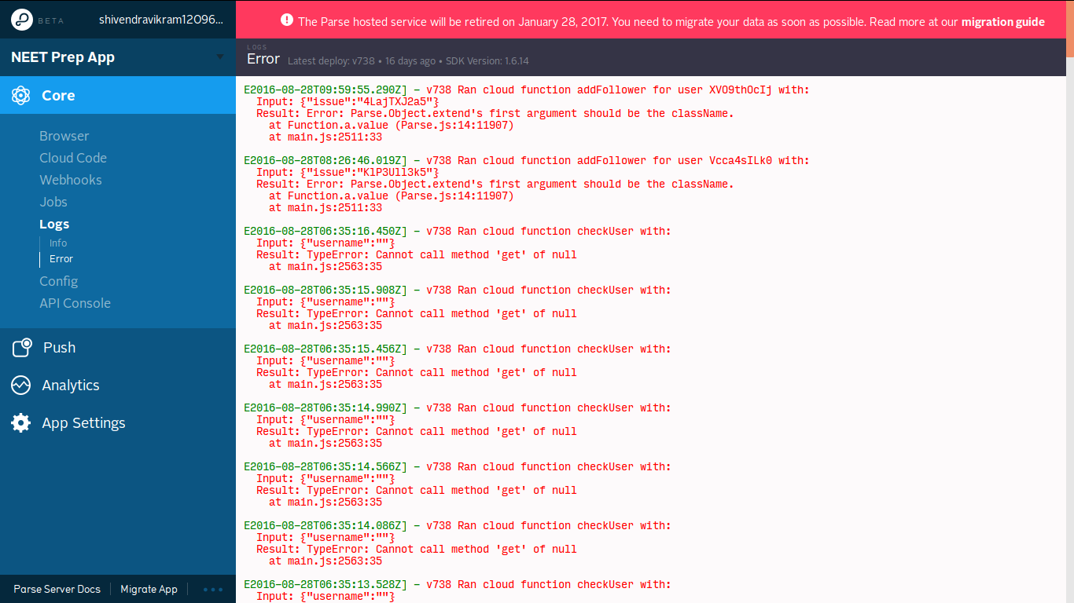
Server Logs:

Slide 9
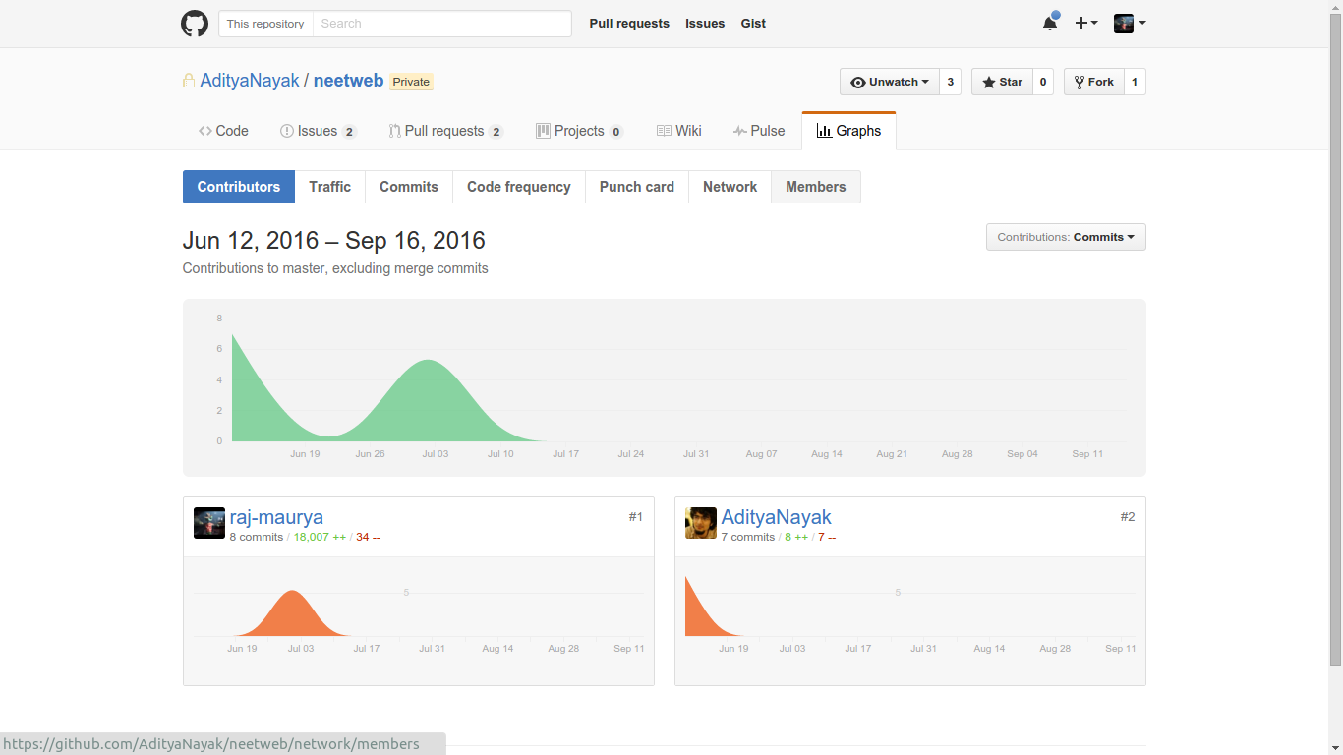
My Code Contribution Frequency (GitHub)
More than 18000+ lines of code contribution

Slide 10
Supervisor
Two supervisor:
Supervisor | Job Title
Aditya Nayak | Senior Software Engineer at Xerox
Ghanshyam Tiwari | CEO (GoodEd Technologies)

Slide 11
Learning Outcomes
If you don not know something you can always go and ask
Be simple, professional, formal and creative
Organizing your work and put a timeline make your work easier
You can learn by observing more than asking
CAR technique: Case, Action and Result. It’s a technique we need to use if we want to accomplish any task in an effective way
Learnt Software Engineering Techniques (API, Server Side Coding, Client, UI)
Notes:
There is black for negative, yellow for positive, green for creativity, blue for facts, red for emotions.
<number>

Slide 12
Organization evaluation
Environment
Good, friendly, exciting
Employee
Kind, friendly, respectful, helpful

Slide 13
Internship effect
After approx. 2 months got PPO:
Position
Money
Job title

Slide 14
Thank you

